Slide 1
Faith and Mental Health
With Rev’d Julie Lomas
Notes:
Prayer

Slide 2
How am I? What can you tell about my state of health by looking at me?
Notes:
Give everyone 60 seconds on their table to decide
Then pull out insulin pen
Then pull out pack of tablets
Shout out answers

Slide 3
How are you?
Notes:
On your table, take a good look at each other and in 60 seconds make a guess as to how people are today

Slide 4
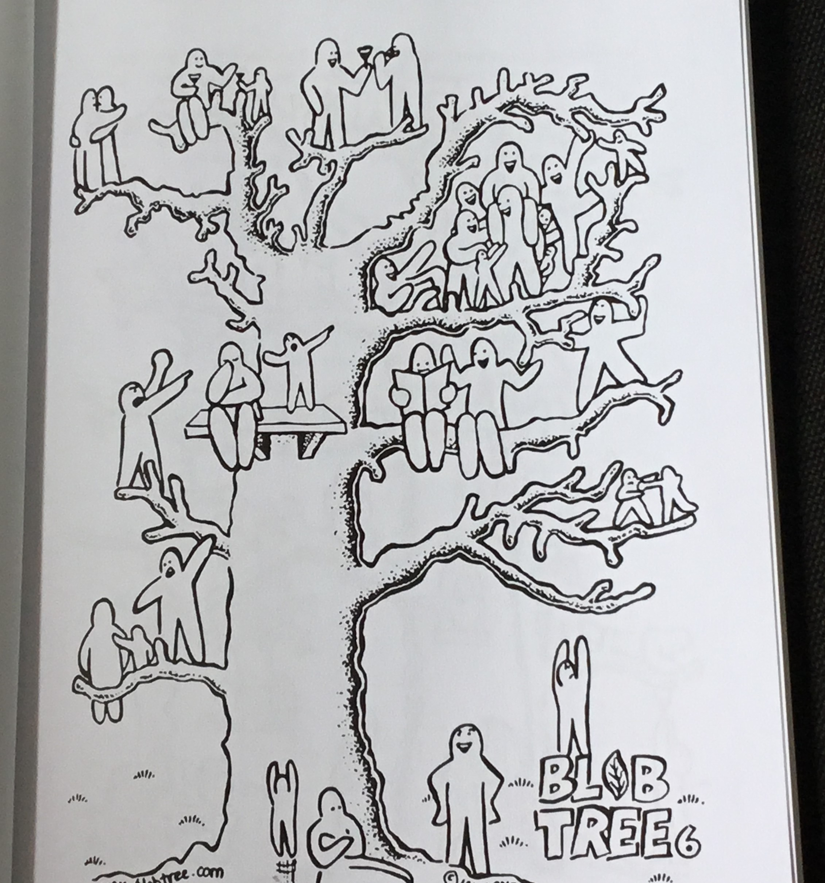
Notes:
Use the blob tree on the table, and look for a blob person who matches how you actually are today
Is there a difference between how you look to other people, and how you actually are
No need to shout out
Does anyone want to say anything?

Slide 5
Do you recognise any of these? - what do I do if I feel stressed all the time? - I can’t control my anger. When it comes I completely lose control - there is this group of girls who have set themselves the challenge of seeing how long they can go without eating. I want them to like me, so I will join in. - I only leave home to go to school. The rest of my life is spent online
Notes:
Read out the statements
Raise a hand if you know anyone who would say Yes to any of these

Slide 6
Apart from “happy” and “sad” what are the top 10 other emotions you think your age group feel most often?
Notes:
Give each table up to 2 minutes to list their top ten
Pens and paper available

Slide 7
Anger Excitement
Stress Confusion
Worry Joy
Fear Loneliness
Jealousy Depression
Notes:
These are the top ten
Does anyone want to add to this list?
Do you recognise your own feelings in this list?

Slide 8
“emotion” = e - motion ie energy on the move emotional health = 1. a balance of positive and negative emotions 2. that can be expressed appropriately

Slide 9
Did you know………? - our brains like it when we notice and respond to difficult emotions, even when they make us feel bad? - for every one negative comment we hear we need at least five positive ones to restore the balance

Slide 10
True or false………? - People in churches struggle with mental health issues - it helps in church if we avoid speaking about mental health because we don’t want to upset anyone - people with mental health issues can’t serve in church – it’s too much for them - prayer works and it helps and so does medication and other therapy - people who are ill have either sinned or have not got enough faith
Notes:
Talk through each statement
Stand up if you think it true and stay sat down if you think its false
Its not a test! What you think is equally valid to the next person

Slide 11
Faith and mental health
1 Kings 19 – Elijah experiences depression and has suicidal thoughts
Psalm 88 – King David feels abandoned and isolated
Job 3 – Job wishes he had never been born
Notes:
Sometimes it is good to read the Bible with a particular set of glasses on
My glasses come with a setting that allows me to read the Bible looking out for people who have mental health problems and issues
Here are just a few of the stories that you may already know, but which I think can be read as true to the human condition, where mental health is challenged

Slide 12
Faith and mental health
Lamentations – a whole book of the Bible exploring negative emotions, loss, grief and despair
Mark 3 v 19b – 21 – Jesus’ family arrive worried that he has gone out of his mind
Matthew 26 v 36 – 46 – the account of Jesus’ anguish in the garden of Gethsemane

Slide 13
Faith and mental health
Psalm 23 – I walk through the valley of the shadow of death
Jeremiah 8 v 18 – my joy is gone, grief is upon me, my heart is sick.
Notes:
So how do you read the Bible?
Is there anything in the Bible that says Christians are immune to problems?
Or that Christians are immune to pain and suffering?
Of that Christians are immune to mental health issues?

Slide 14
What can we do?
Notes:
Let’s have some ideas….
On your table, come up with just one thing that you think we can do about faith and mental health
60 seconds starts now

Slide 15
What can we do?
Regular exercise
Eat well, and drink lots of water
Avoid self medication through alcohol & drugs as these are not the “pick me up” that they claim – rather they cause more brain damage
Sleep well – make your bed a sacred space so that you go to work from a place of rest
Learn to breathe
Notes:
Here are some suggestions to add to those you have made
And funnily enough these apply to all aspects of our human life – taking care of ourselves, our whole selves, is part of our calling to be human beings

Slide 16
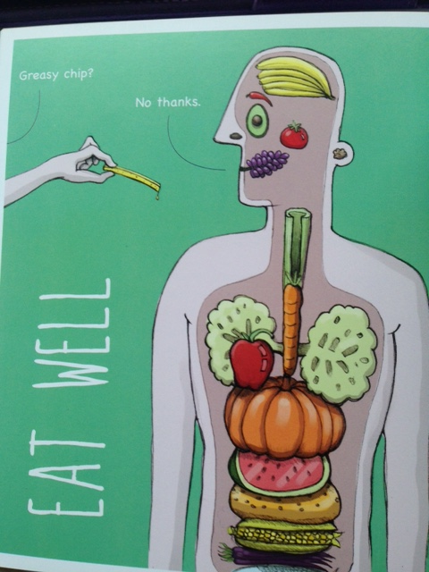
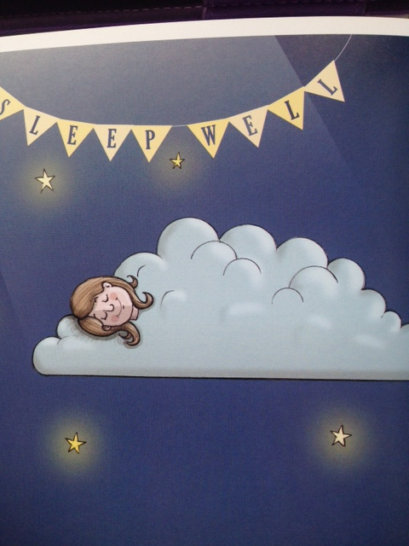
Notes:
Anyone want to say anything about these two?

Slide 17
What can we do?
Connect to something bigger than ourselves – our faith, our family, our church, our community – when we give of ourselves, we receive
Try something new- get involved, help yourself by helping others
Have a digital detox
Keep good company – avoid “dementors”
Learn forgiveness
Notes:
Anything on here that might be a real challenge for any of us, but particularly for your age group?

Slide 18
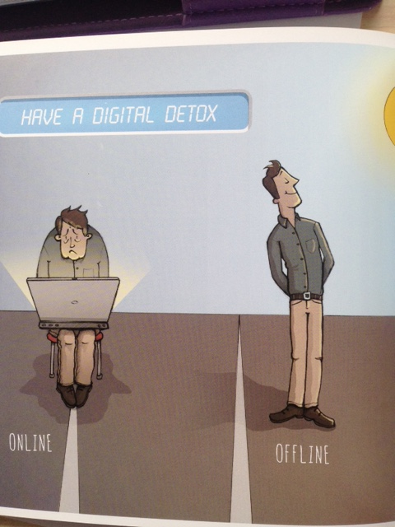
Notes:
What is it about our faith in Jesus that might help us with these two in particular?

Slide 19
What can we do?
Practice the lost art of Christian meditation
Big THANKS for little things, keep a gratitude diary
Communicate – listen as well as talk
Grow from adversity
Always hold on to hope & Live with Love
Notes:
A total of 15 ideas –
What would be the impact of these ideas on the young people you know if you began to practice some of these?
What would be the impact of these ideas on young people in church if you began to practice some of these?

Slide 20
What can we do?
Subscription aPPS
- Abide-Christian meditation
- Calm - mediation
Websites:
www.thriveport.com/products/moodkit
www.moodtools.org
http://positivepenguins.com
www.headspace.com
www.moodpanda.com
www.prevent-suicide.org.uk
www.stem4.org.uk/calmharm
www.moodscope.com
www.superbetter.com
www.childline.org.uk/toolbox-for-me
http://Sam-app.org.uk
Notes:
Help is at hand!
This is just a sample of on line resources that you can go to at a time and place that suits you
These have been recommended to me by a young person who lives with severe anxiety, and by someone who works in schools as a nurse
There is a longer list if anyone is interested!

Slide 21
Two sayings of Jesus
The second commandment is this:
Love your neighbour AS YOU LOVE YOURSELF
A new commandment I give you – that you LOVE one another as I have LOVED YOU
Notes:
What about God?
Faith and mental health – how do you love God, love yourself, and love other people?
John 3 v 16 says this
For God so loved the world that he gave his only begotten son that whoever believes in him shall not perish but have everlasting life.
And v 17 says this
For God did not send his son into the world to condemn the world, but that the world might be saved
Offer to speak one to one; point out resources
Prayer

